Slide 1


Micro-course in
DATA ANALYSIS
Session – 2
Introduction to Python

Slide 2

Why python popular ?
Beginners friendly
Cross platform
Huge community
Wide Ecosystem

Slide 3
Features of Python
High level language
Easy to learn
Interpreted
Object oriented
Applications of Python
Data Analysis
Scientific and computational applications
Web development
Game development

Slide 4

Open-source distribution for Python and R
Used for data science, machine learning, deep learning etc.
More than 300+ libraries for data analysis
Package versions are managed by package management system called Conda

Slide 5

Open-source web application
Allows you to create and share documents that contain live code, equations, visualisations and narrative text.
Markdowns and other additional functionalities are available
Best platform for getting started with data analysis using programing language.

Slide 6
Introduction to Jupyter Notebook
Creating a new Notebook
Renaming the Notebook
File menu
Kernel:
portion of OS code that is always resident in the memory.
Command icon palette
Cell: Code/Markdown
Command mode and Edit mode
Running the code cells

Slide 7
Variables
A way to label data
Used to store information to be referred and manipulated in a computer program
Rules for variable names:
Must start with a letter or underscore
Cannot start with a number
Can contain only alpha-numeric characters and underscores
Are case sensitive (conventionally we use small case)
Keywords in python can’t be used

Slide 8
Data Types
Determines the type of data that is stored
Different data types in Python:
Number
String
List
Tuple
Dictionary
Python is a dynamic programming language

Slide 9
String Data Type
Len function
To get the length of the string
Count function
To count the number of occurrence of a single character in a variable

Slide 10
List
Used to store a group of elements or objects
Heterogeneous
Dynamic
Can store duplicate elements
Mutable
Indexing & Negative Indexing
Slicing
len & count
Replace
Append & insert
Remove and pop
Extend a list with another

Slide 11
Tuple
Same as list, but immutable
Sequence of immutable python objects
Dictionary
Represents a group of objects as key-value pair
Dictionaries are enclosed in curly braces { }
Key and Values are separated by colon :
Different key-value pairs are separated by commas
Mutable
Duplicate keys are not allowed, but duplicate values are allowed
Can’t use indexing and slicing concept

Slide 12
Operators
Used to perform different operations on variables and values
Python divides operators into following groups:
Arithmetic
Relational
Logical
Membership
Assignment
Identity
Bitwise

Slide 13
Arithmetic Operators
Addition ( + )
Subtraction ( - )
Multiplication ( * )
Division ( / )
Modulus ( % )
Exponent ( ** )
Floor division ( // )

Slide 14
Relational Operators
Here we are comparing operands to get a value
Greater than ( > )
Less than ( < )
Equal to ( == )
Not equal to ( != )
Greater than or equal to ( >= )
Less than or equal to ( <= )
Normally return a Boolean value

Slide 15
Logical Operators
Used to construct compound condition.
Each single condition gives a Boolean value which is evaluated to return final Boolean value.
and : if both argument is true, result is true
or : if at least one argument is true, result is true
not : compliment the Boolean value

Slide 16
Identity Operators
Used to determine whether a value is of certain class or type
is : Evaluates to true if variable on either side of operator points to same object
is not : Evaluates to false if the variable on either side of operator points to same object

Slide 17
Membership Operators
Used to validate the membership of the value in a sequence, i.e., strings, lists or tuples
in : used to check if a value exist in a sequence or not.
not in: evaluates to true if it doesn’t find the variable in the specified sequence.

Slide 18
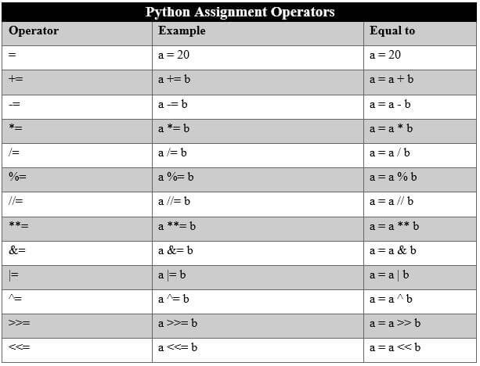
Assignment Operators
Used to assign value to a variable

Slide 19
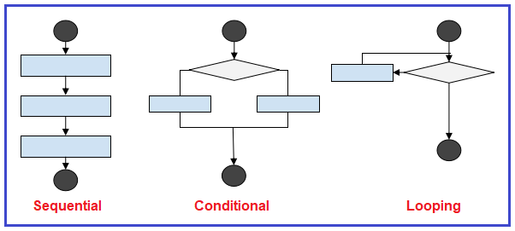
Control Structures
A way to specify flow of control in a programme
It analyses and chooses in which direction a program flows based on certain parameters and conditions.
Three ways in which a statement can be executed:

Slide 20
Sequential:
Statements are executed one after the other in a sequential manner
Conditional:
Statements are executed based on certain condition
if..else control structures are used in this case

Slide 21
Looping (or Iteration):
Set of statements are executed repeatedly until the condition becomes false.
for and while are used for looping.
for loop:
Iterates over a compound data type like a string, list or tuple.
During each iteration one member of compound data type is assigned to loop variable

Slide 22
while loop
Logical expression in front of while loop is evaluated and if it is true, body of the while loop is executed.
Process is repeated until condition becomes false.
⚠ we should have some statement inside body of while loop which makes the condition falls after few iteration

Slide 23
Modify loops: break and continue
break statement is used to terminate a loop, if some condition is met.
continue keyword is used to suspend a particular iteration in a for/while loop and continues to next iteration

Slide 24
Functions
A block of organised, reusable code that is used to perform a single related action.
In-built functions: input(), print(), etc.
User-defined functions: functions created by user.
we define a function with keyword def

Slide 25


Thank You

